Slide 1
What is Anime?
By: Shane Grimes

Slide 2
Learning what anime is and how it reached American Culture in the 2020s.
Introduction
Migration to America
Toonami and early viewing
2018 and beyond
Suggestions for New Watchers

Slide 3

Japanese
Drawings
MANGA

Slide 4
Manga
Most anime is based off their Mangas.
Dating back to the 11th Century, Traveling story tellers would narrate legends and use shadow work to pictify their stories.
In the early 20th Century with the introduction of filmmaking, Japanese artists started experimenting with animations.
The first professional anime was Namakura Gatana, produced by Oten Shimokawa, Seitaro Kitayama and Jun’ichi Kouchi.
These three are referred to as the “Fathers of Anime”.
Animation was introduced to America when Disney started drawing Mickey Mouse.
Animation however, is not the same as Anime.
Unlike Disney, anime artist emphasize art quality with limited movement.

Slide 5

Reaching the west
Robot series in Japan such as Gundam and Super Dimension Fortress Macross were instant classics in the 80s.
International success was found in the late 80s with Akira Toriyama’s Dragon Ball.
Dragon Ball Z, the sequel series, and Sailor Moon were the two anime heading the Western front. Both being translated (called “dubbed” in anime culture) into over a dozen languages at the time.
The new, to western watchers, art styles, methods of animation and production were a huge hit for the American watchers.
Action packed with characters that people could connect with, Anime was ready to explode in popularity.
Anime is cinematically shot as if by camera, differentiating itself from Western animation of cartoons.

Slide 6
Who cares
Growing up in the 90s I have been an Anime watcher as long as I can remember
As I watch the anime culture creep its way into mainstream, I wanted to provide a means for people to dive into the world without being overwhelmed by its vastness

Slide 7
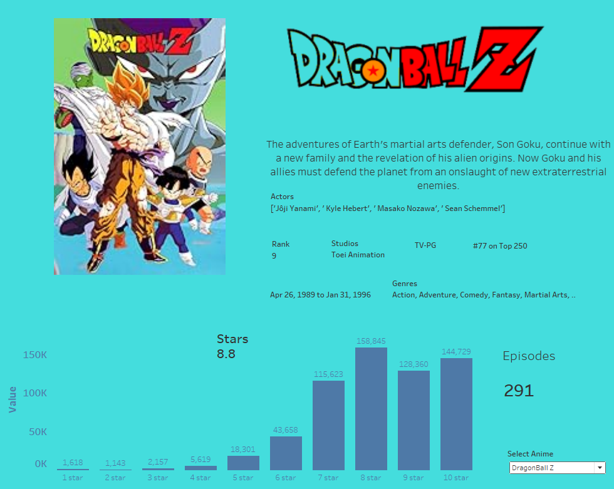
Dragon Ball Z
Appearing at number 63 on the all time television list with 291 episodes, Dragon Ball Z lasted on Toonami for the duration of the block
Having over 200,000 votes, the overall viewer rating of 8.8 stars proves that Dragon Ball Z was an anime that almost everyone loved.
Only 8% of voters gave the show less than 6 stars

Slide 8

Toonami​
A programming block on Cartoon Network, that ultimately served as a gateway for dubbed anime series
80% of anime viewers were introduced to anime through Toonami.
Reaching mainstream status in 1999, the success of Toonami was the beginning of an era.
Dragon Ball Z was the most watched anime in 2001 on Toonami, with an audience share of 11.4%

Slide 9
The 2000s
The explosion of Toonami led to more and more shows wanting to be on the block, such as Naruto and One Piece.
This led to concerns that the weekday block was proving to be too action packed and considered violent
Cartoon Network forced Toonami to a Saturday evening slot.
This eventually would prove to be the end of Toonami, with a cancellation announcement in 2008.
4 years later there was a teaser on Adult Swim in which they tested the power of social media to see if people wanted Toonami back.
They played the old shows Dragon Ball Z, Naruto, One Piece, and Sailor Moon

Slide 10
The 2010s
Adult Swim, another Cartoon Network block, aired some old Toonami shows in 2012 during a nostalgia era. Creating a wave of renewed interest in Anime.
This surge in interest led to the cultural phenomena that anime has played on American culture since 2018, led by Demon Slayer, the highest grossing anime movie of all time
Streaming services have given access without much restriction to anime viewers. 74% of Netflix subscribers have watched anime on the platform
The dubbed market has grown by 150% since 2016
The Covid pandemic saw the highest anime viewership in history with market share increasing by 72% in 2020

Slide 11

Demon slayer
Leading the culture through modern anime is Demon Slayer with a rating of 8.9 with only 7.8% of voters giving less than 8 stars.
The show has over 150, 000 votes and in its short life of only 4 years, it has reach rank 163 on the top 250 all time television list of IMDB.

Slide 12
How to start watching
With 23,000 anime series, it can be intimidating to try to start watching.
There are dozens of genre, different TV ratings, and varying animation styles.
Upcoming is a source to help new watchers get started in the great world of anime.

Slide 13
How to decide
https://public.tableau.com/app/profile/shpunji/viz/NSSAnime/TitlePage?publish=yes
I’ve compiled a list of 60 anime that have the best viewer ratings overall.
These anime cover a multitude of genres and anime styles
Each of the anime provided have at least 72% of their reviews being greater than 7/10 stars
Some of these anime are also on the Top 250 all time television list based off viewer ratings

Slide 14

In conclusion
Welcome to anime
It’s a thrilling experience
I hope the dashboard is useful to you in your decision making process.
Anime is dear to me and I am grateful for an opportunity to share with others.

Slide 15
THANK YOU
Shane Grimes​
Nashville Software School
Full Time Data Analytics

